Slide 1
Class Diagram

Slide 2
We Will Cover
What is a Class Diagram
UML Class Notation
Class ,Class Name, Class Attribute, Class Operator
Class Relationships
Example of Class Diagram

Slide 3
What is a Class Diagram
Class diagrams are one of the most useful types of diagrams in UML as they clearly map out the structure of a particular system by modeling its classes, attributes, operations, and relationships between objects

Slide 4
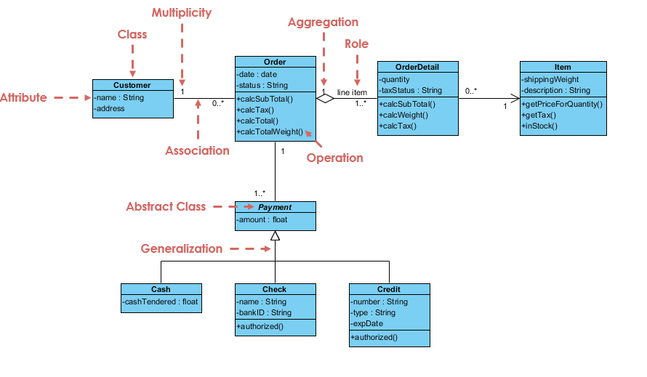
Class Diagram Example

Slide 5
Class
Describes a set of objects having similar:
  Attributes (status)
  Operations (behavior)
  Relationships with other classes
Attributes and operations may
  have their visibility marked:
  "+" for public
  "#" for protected
  "−" for private
  "~" for package
Class Name
Window
size: Size
visibility: boolean
Attributes
display()
hide()
Operations

Slide 6
Class- Names
ClassName
The name of the class is the only required tag in the graphical representation of a class.
It always appears in the top-most compartment.
attributes
operations

Slide 7
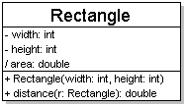
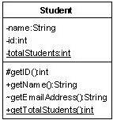
Class Attributes
attributes (fields, instance variables)
  visibility name : type [count] = default_value
  visibility: + public
  # protected
  - private
  ~ package (default)
  / derived
  underline static attributes
  derived attribute: not stored, but can
  be computed from other attribute values
  attribute example:
  - balance : double = 0.00

Slide 8
Class Operations / methods
operations / methods
  visibility name (parameters) : return_type
  visibility: + public
  # protected
  - private
  ~ package (default)
  underline static methods
  parameter types listed as (name: type)
  omit return_type on constructors and
  when return type is void
  method example:
  + distance(p1: Point, p2: Point): double

Slide 9
Visibility of Attributes and Operations
Visibility
Symbol
Accessible To
Public
+
All objects within your system.
Protected
#
Instances of the implementing class and its subclasses.
Private
-
Instances of the implementing class.
Notes:
Operations in a Class
Also can be shown on attributes
Put in front of the name of the attribute or operation on the class diagram
Visibility of the attribute/operation in the system
Public – not hidden from any object
Protected – hidden from all other classes except its immediate subclasses
Private – default; hidden from all other classes

Slide 10
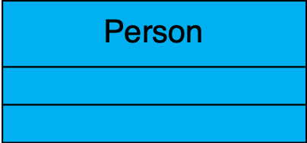
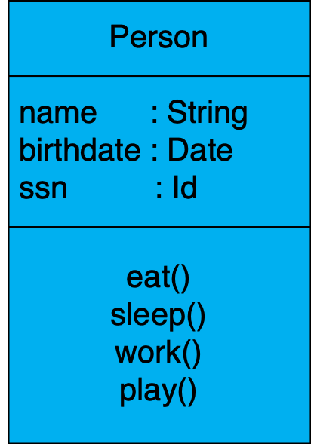
Depicting Classes
When drawing a class, you needn’t show attributes and operation in every diagram.
Person
Person
name
address
birthdate
Person
eat
play
Software Design (UML)

Slide 11
2 Kinds of Classes during Analysis
Concrete
  Class from application domain
  Example: Customer class and Employee class
Abstract
  Useful abstractions
  Example: Person class
Notes:
Concrete
Used to create objects
Abstract
Person class is really a generalization from Customer class and Employee class
Attributes and methods common to both Customer class and Employee class
Examples of common attributes: name, address, birthdate, phone number, email address
Generally do not create objects from Person class but rather create and use employee and customer objects
Later in the design and implementation phases, we will also identify other classes such as user interface classes, data structure classes, document classes, file structure classes, operating environment classes, and various types of multimedia classes.

Slide 12
Relationships btwn. classes
generalization: an inheritance relationship
  inheritance between classes
  interface implementation
association: a usage relationship
  dependency
  aggregation
  composition

Slide 13
Arrow notation

Slide 14
Generalization relationships
Generalization (inheritance) relationships
  hierarchies drawn top-down with arrows pointing upward to parent
  line/arrow styles differ, based on whether parent is a(n):
    class: solid line, black arrow
    abstract class: solid line, white arrow
    Interface (implement interface): dashed line, white arrow
  Abstract class: Italic text
  We often don't draw trivial / obvious generalization relationships, such as drawing the Object class as a parent

Slide 15
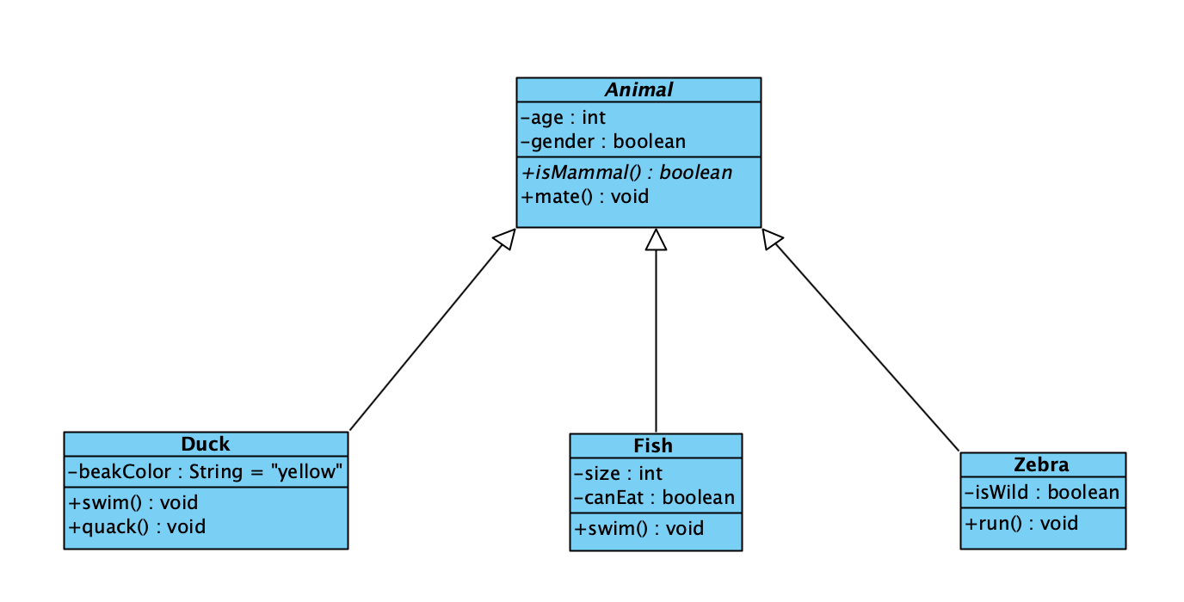

Slide 16
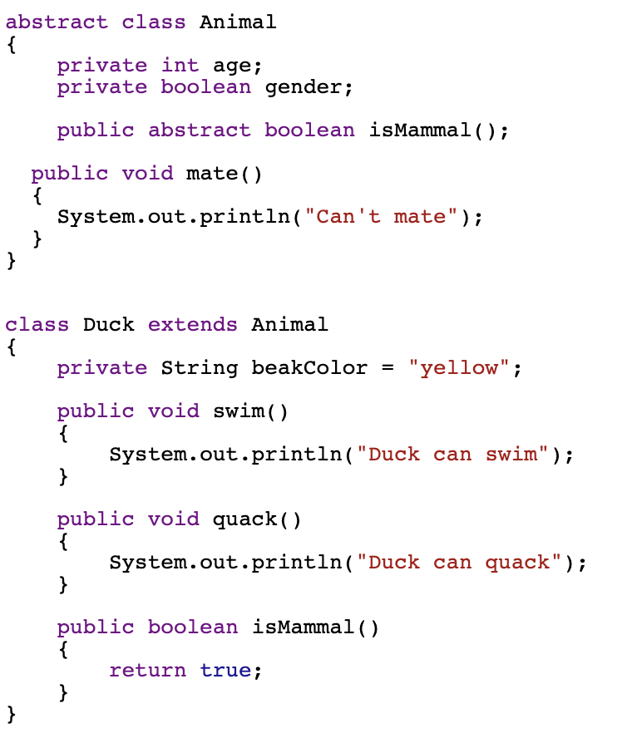
Translate to code

Slide 17
Association Relationships
If two classes in a model need to communicate with each other, there must be link between them.
An association denotes that link.
Student
Instructor

Slide 18
Associations (cont.)
  Multiplicity Indicators
Exactly one | 1
Zero or more (unlimited) | * (0..*)
One or more | 1..*
Zero or one (optional association) | 0..1
Specified range | 2..4
Multiple, disjoint ranges | 2, 4..6, 8

Slide 19
Association Relationships (Cont’d)
We can indicate the multiplicity of an association by adding multiplicity adornments to the line denoting the association.
The example indicates that a Student has one or more Instructors:
Student
Instructor
1..*

Slide 20
Association Relationships (Cont’d)
The example indicates that every Instructor has one or more Students:
Student
Instructor
1..*

Slide 21
Association Relationships (Cont’d)
We can also indicate the behavior of an object in an association (i.e., the role of an object) using rolenames.
teaches
learns from
Student
Instructor
1..*
1..*

Slide 22
Association - Aggregation
We can model objects that contain other objects by way of special associations called aggregations and compositions.
An aggregation specifies a whole-part relationship between an aggregate (a whole) and a constituent part, where the part can exist independently from the aggregate. Aggregations are denoted by a hollow-diamond adornment on the association.
Represent has-a relationship

Slide 23
Association - Composition
A composition indicates a strong ownership and coincident lifetime of parts by the whole (i.e., they live and die as a whole). Compositions are denoted by a filled-diamond adornment on the association.
Represent part-of relationship

Slide 24
Example
Car has engine. If car dies, Engine cannot live on its own
Car has passenger. If car dies, Passenger still live on its own

Slide 25
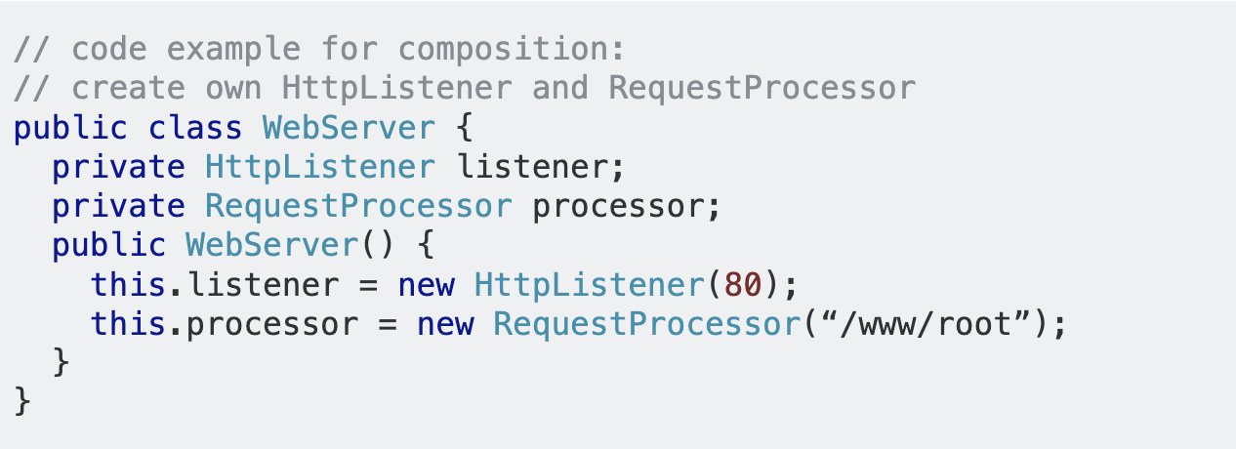
In code
Composition
When WebServer is created by Constructor then Listener and RequestProcessor is created.

Slide 26
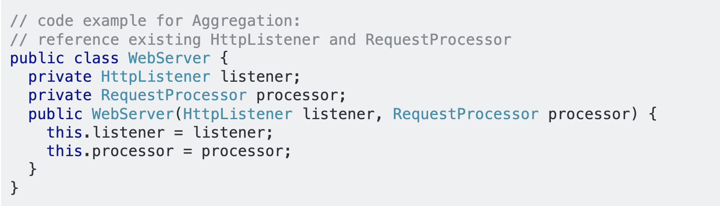
In code - Aggregation
WebServer includes HttpListener (H.L.) & RequestProcessor (R.P.). If WebServer dies, H.L and R.P can still live. H.L and R.P can be created outside, may be in main() class
Aggregation is different from association because of ”owner relationship”.

